Slide 1
Go Green
- an initiative to make your home green…

Slide 2
Team members
Frontend
Yash Dhawan
Mayank Kumar Pathak
Neelu Sharma
Krishanu Dev
Rashmi Bharti
Backend
Ritvik Raj
Asmit Mohan
Harinandan Kumar
Madhuri Kumari
Priti Kumari
45-hour per person (monthly)
60-hour per person (monthly)

Slide 3
What are the problems ?
Limited nurseries
Shortage of time for buying gardening products
Lack of knowledge
Unavailability of specific breeds
Uncertainty in price

Slide 4
Goals of “Go Green”
E-nursery
Home delivery of gardening products
Well formatted planting manual
Provides a variety of breeds
Reasonable price

Slide 5
Technology
Frontend
HTML5
CSS3
Bootstrap 4.0
JavaScript 3.4.1
Backend
Python 3.2.0
Django 3.1
SQLite3

Slide 6
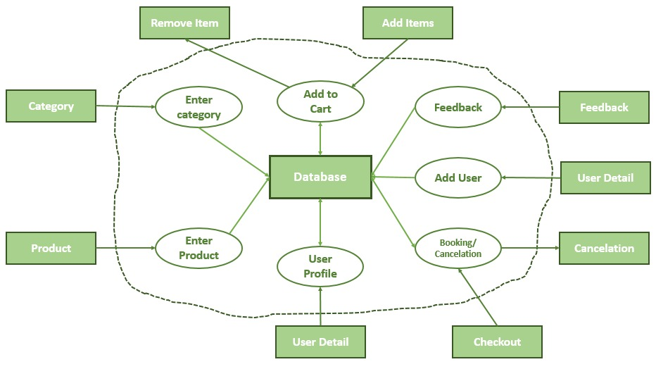
IFD (Information Flow Diagram)

Slide 7
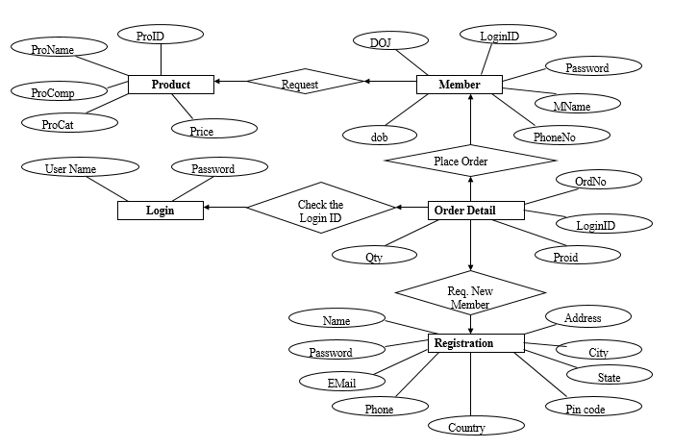
ERD (Entity Relationship Diagram)

Slide 8
System overview
Admin: He/She has rights in the software which include addition/deletion of products, manage user and bookings.
New user: This module is for the users who do not have their account. Here user is allowed to create an account to login. The account creation is done by filling the registration form with user details such as name, phone , email, password and other essential information.

Slide 9
System overview
Product: This module has information regarding the product such as its name, category, image, price and description.
User: He/She can view and book the products available in the stock as well as manage his/her order.

Slide 10
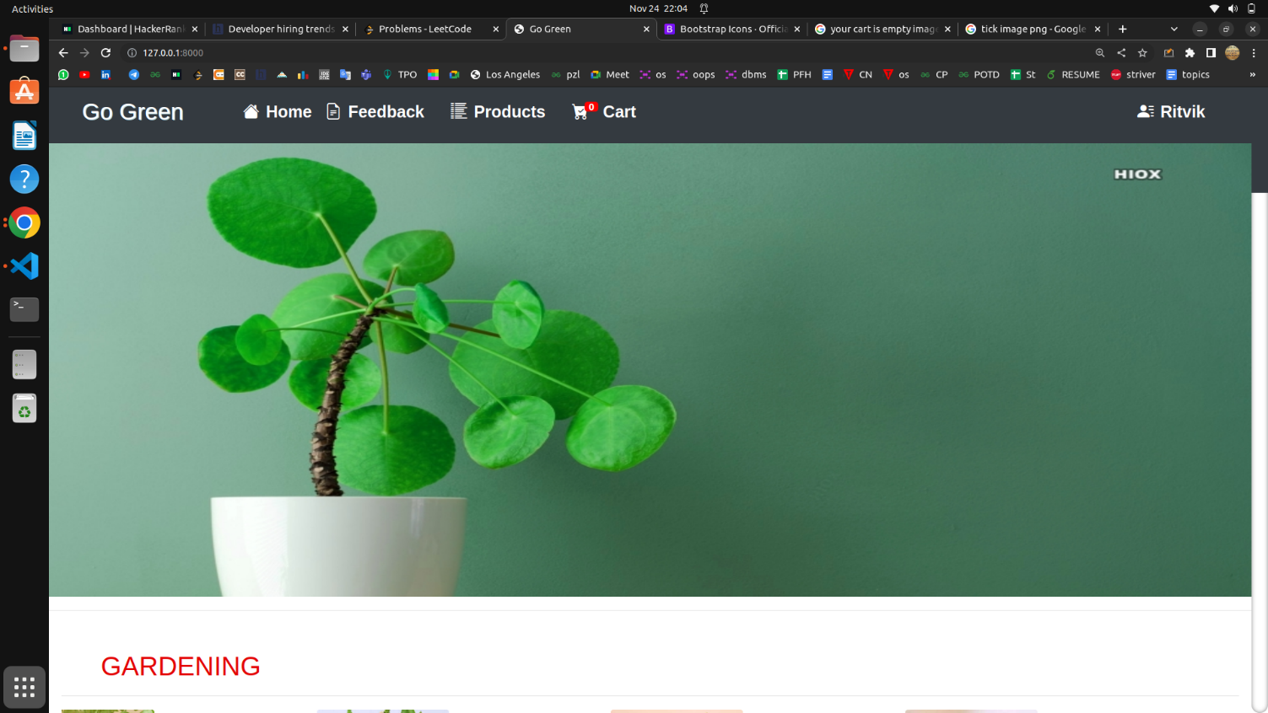
Landing page

Slide 11
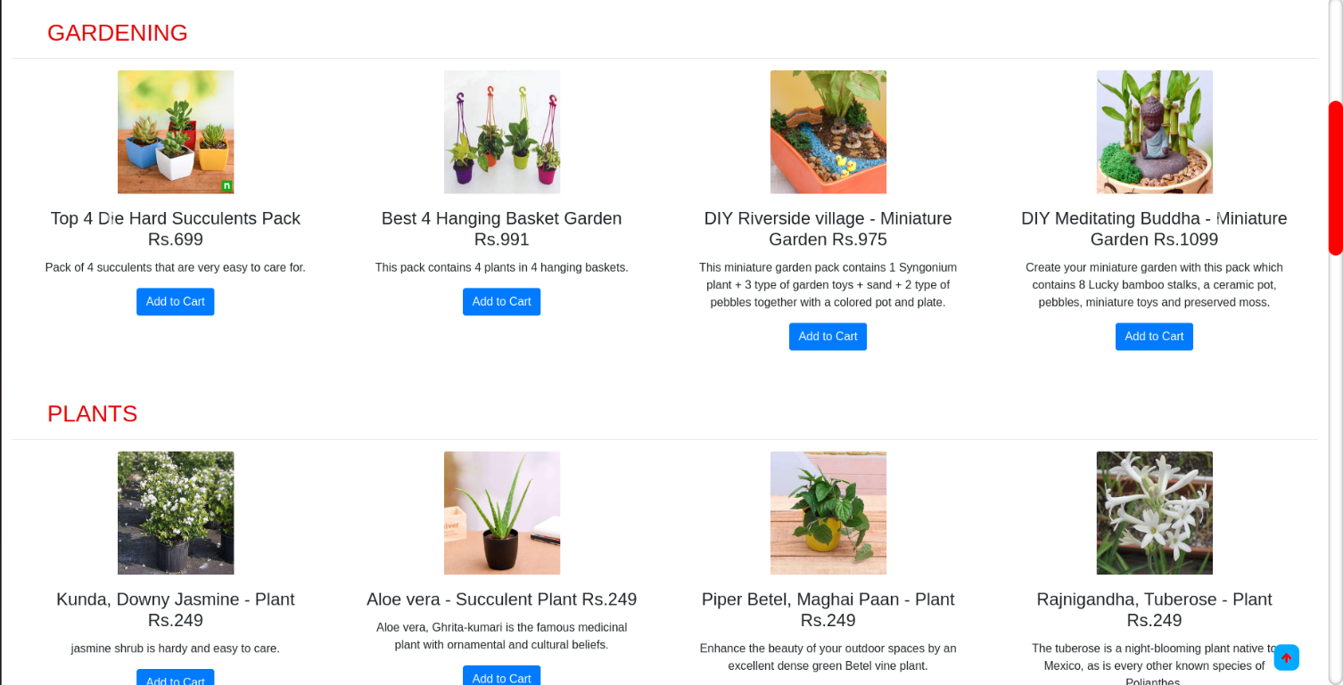
Landing page

Slide 12
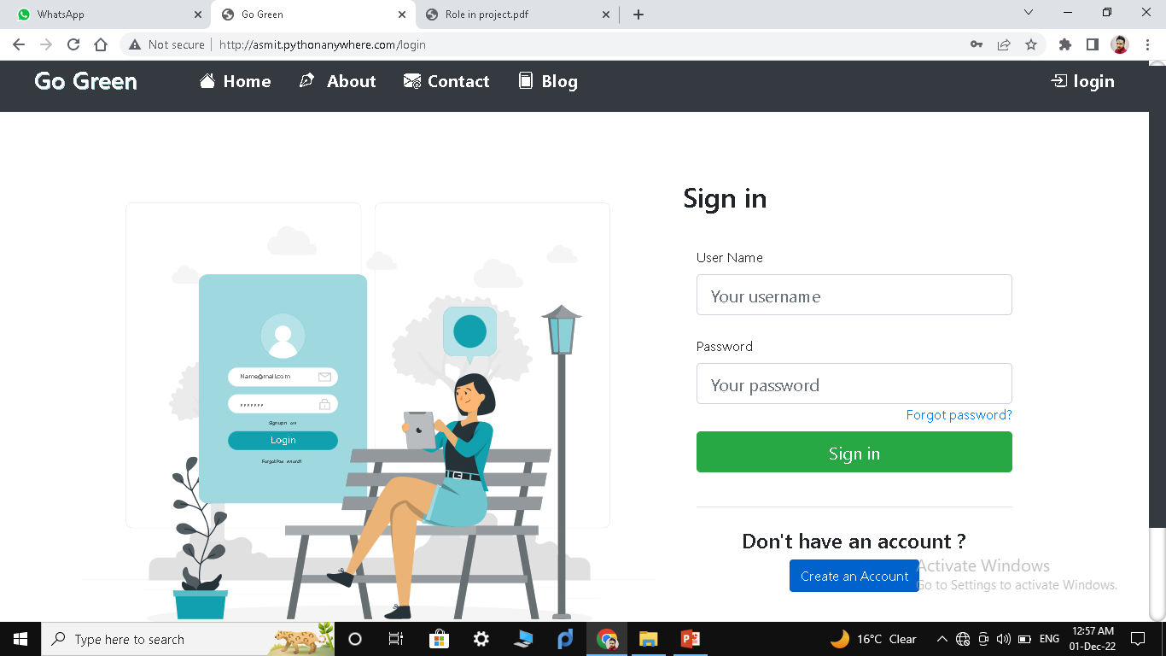
Login

Slide 13
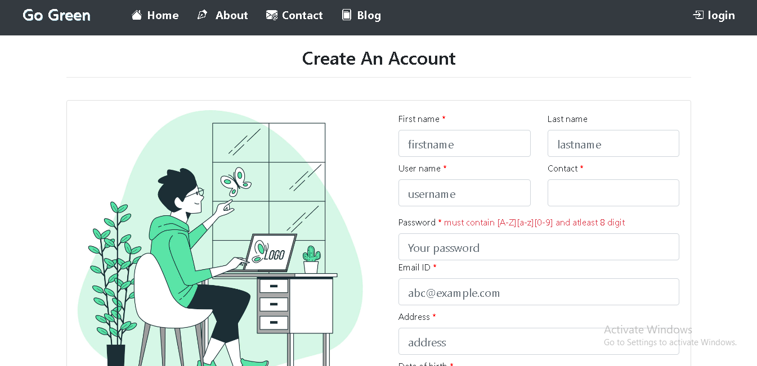
Sign up

Slide 14
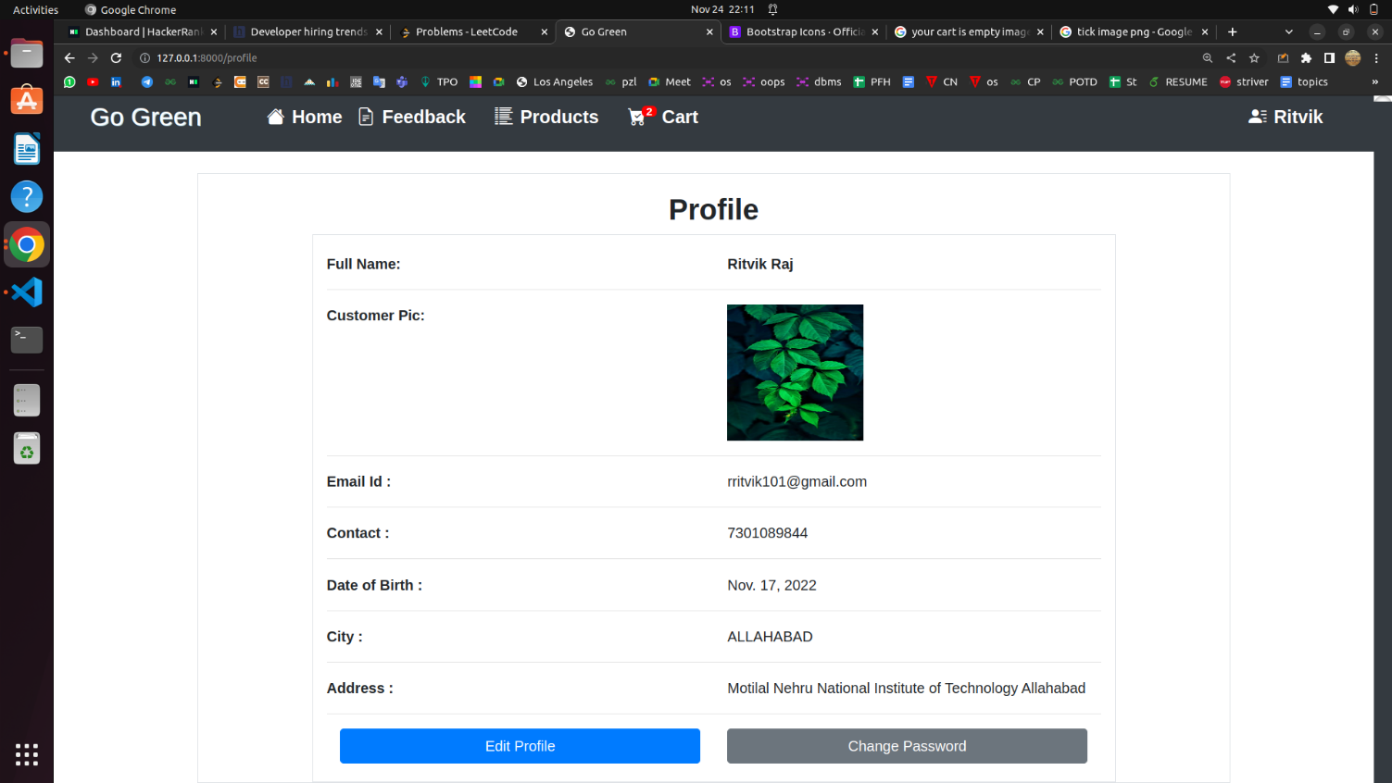
Profile

Slide 15
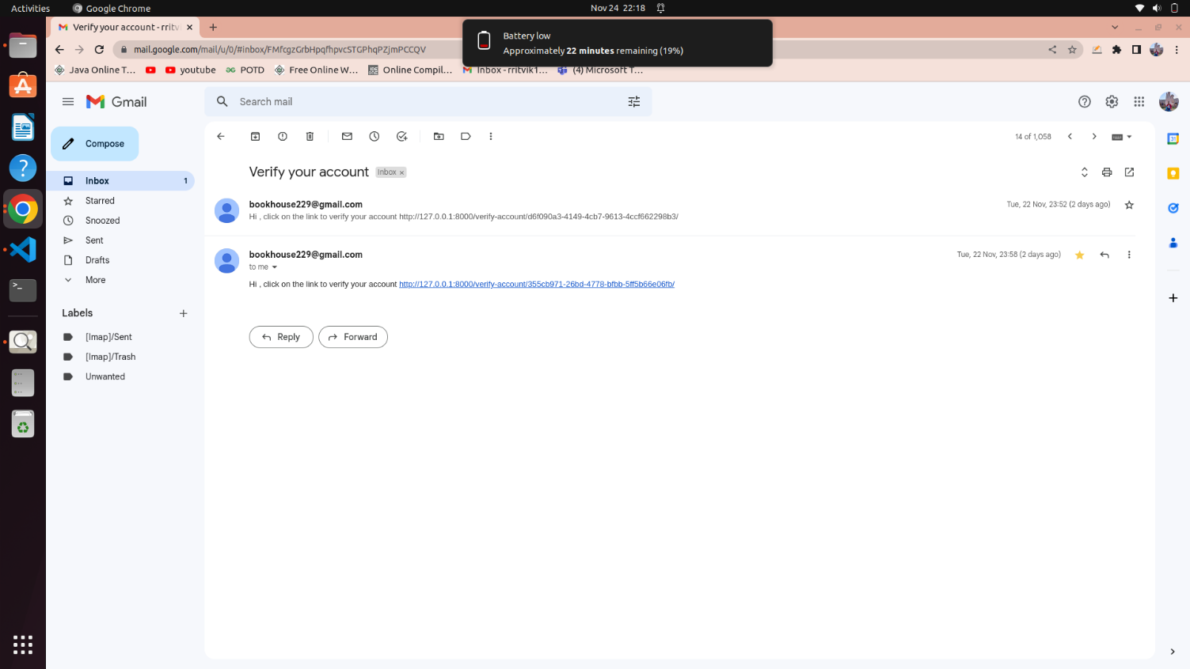
E-mail authentication

Slide 16
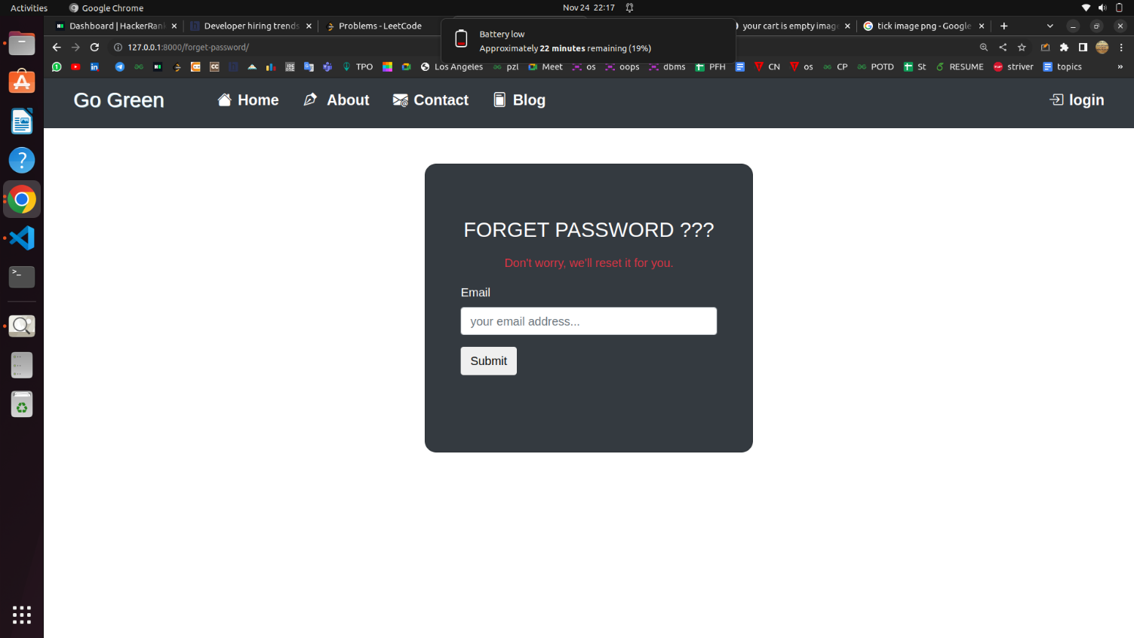
Forget password

Slide 17
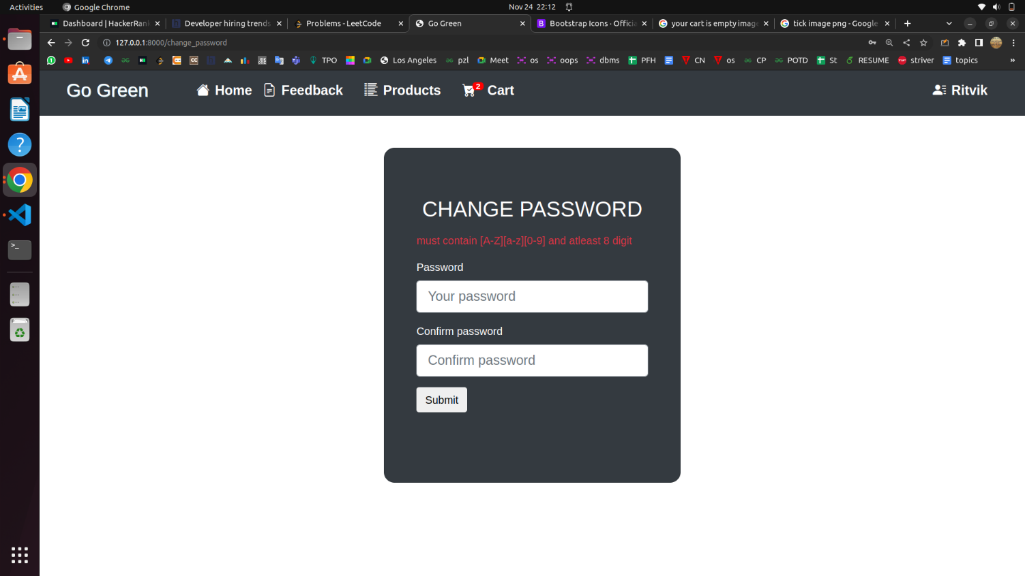
Change password

Slide 18
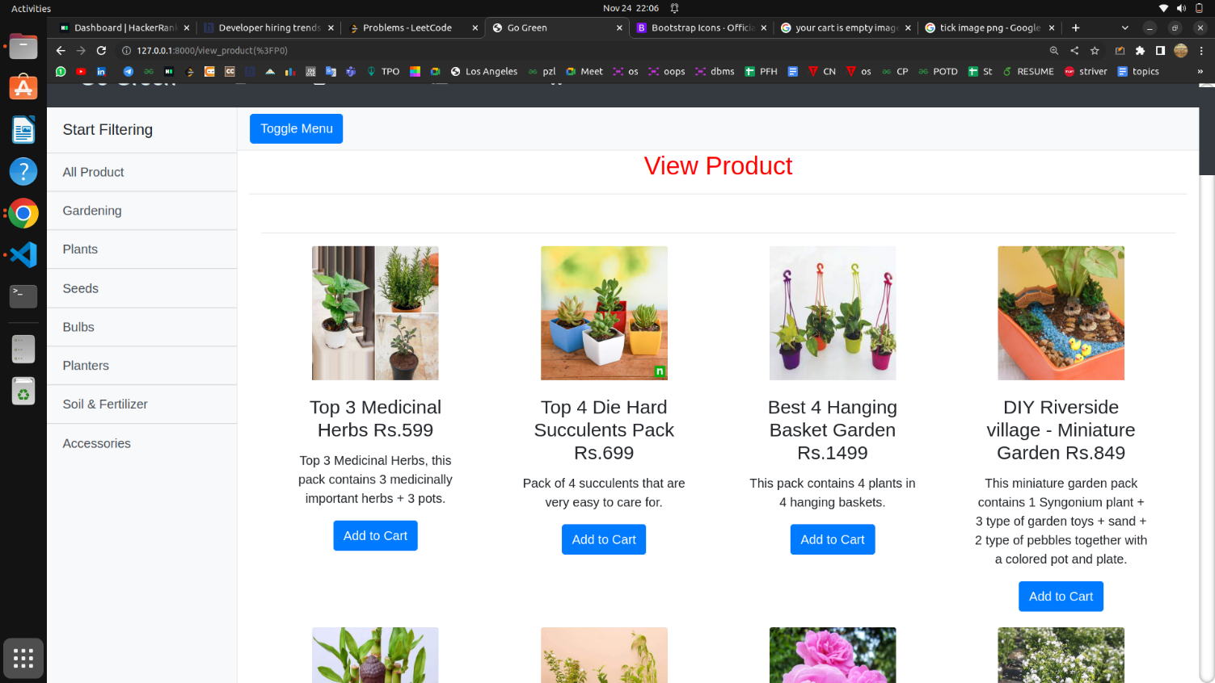
All products

Slide 19
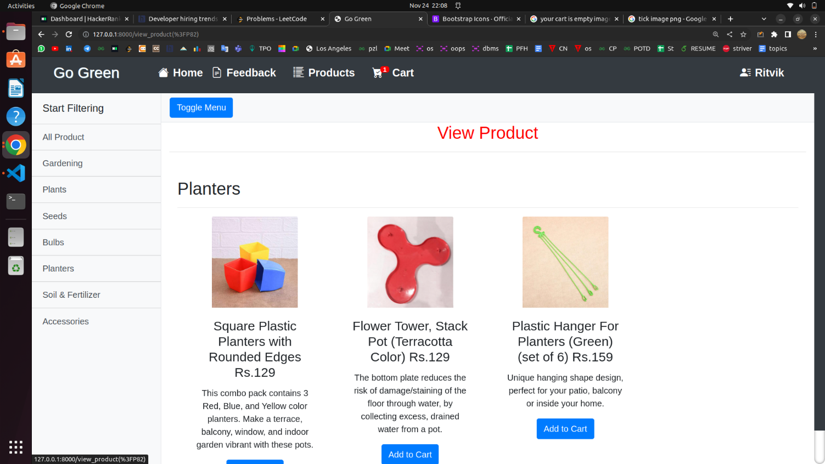
Category search

Slide 20
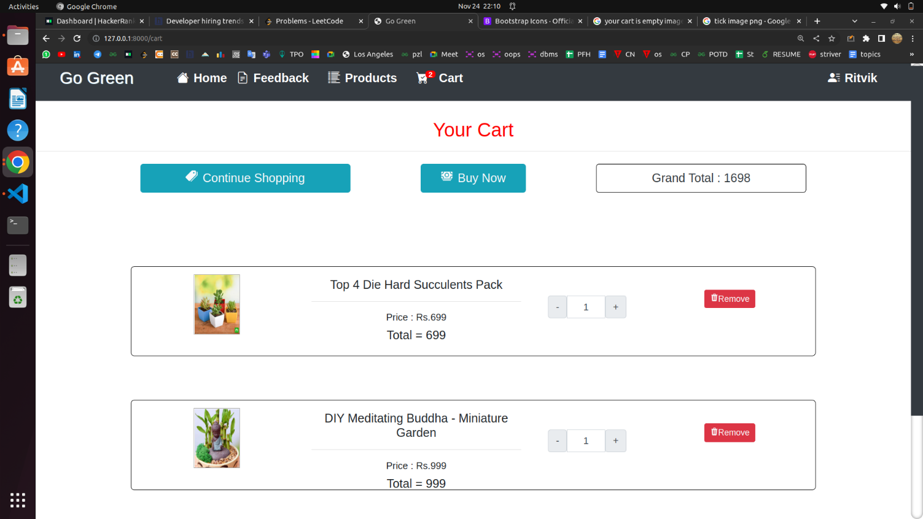
Cart

Slide 21
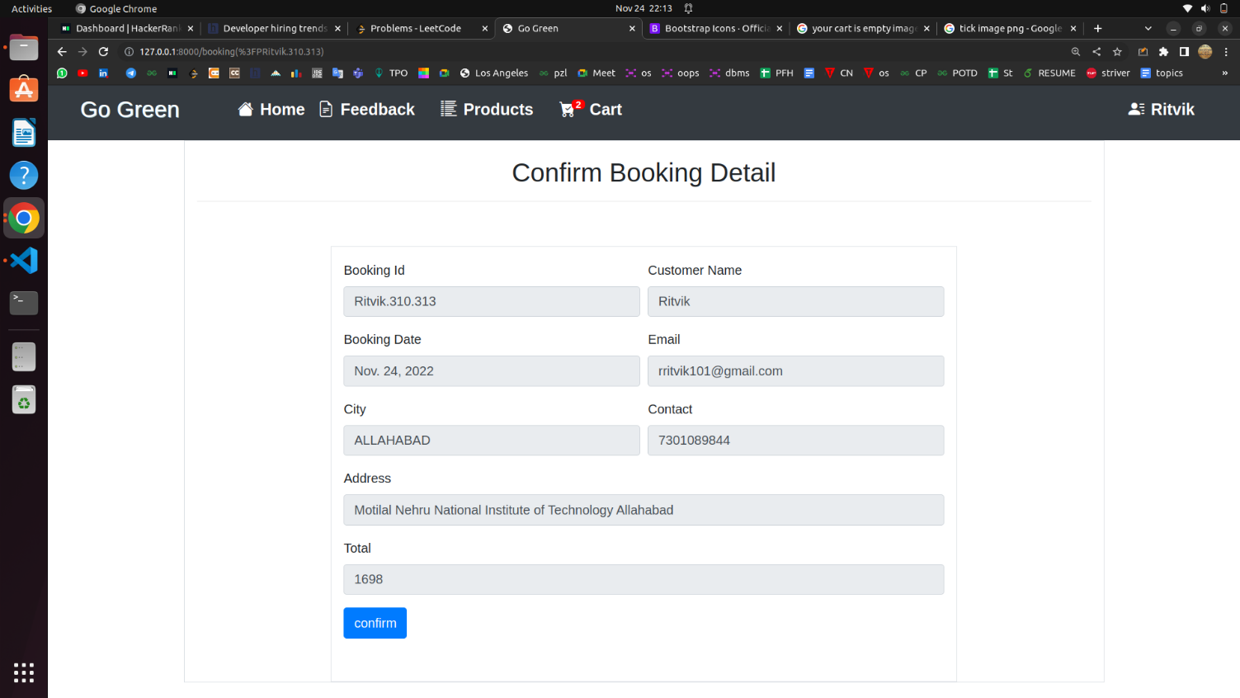
Booking detail

Slide 22
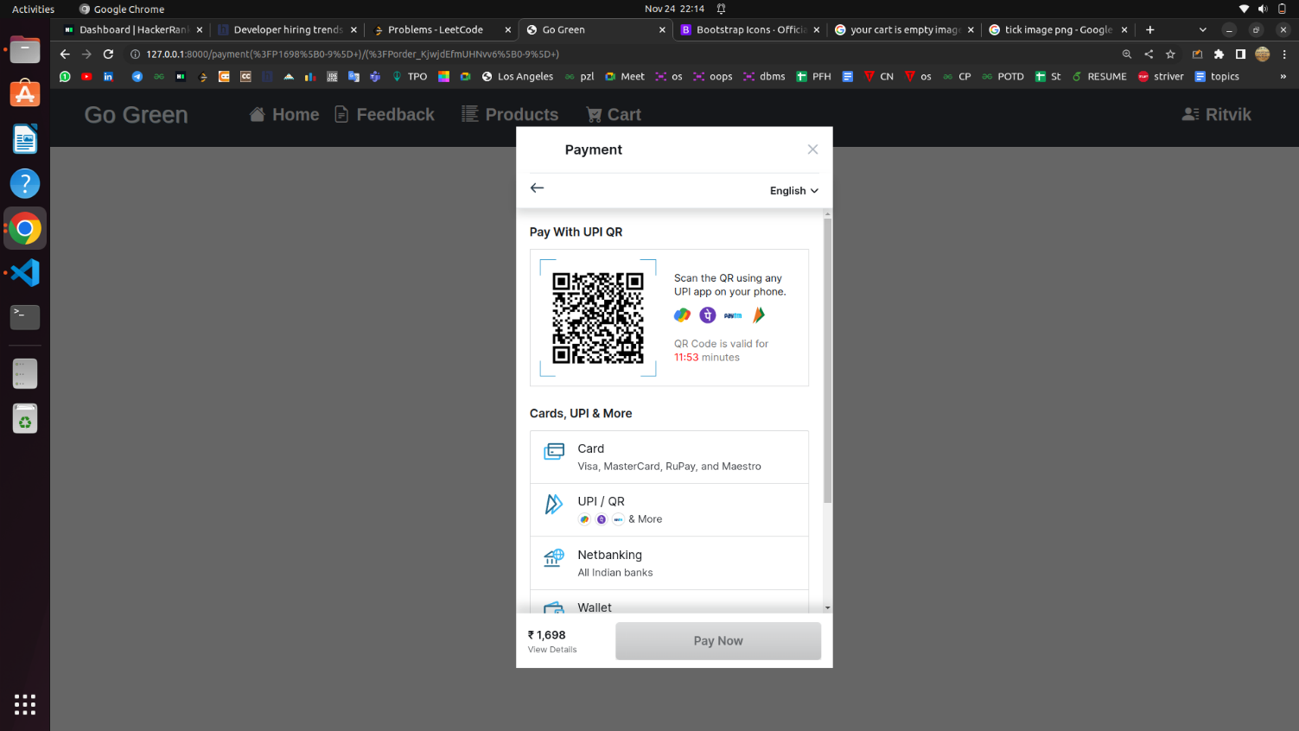
Payment gateway

Slide 23
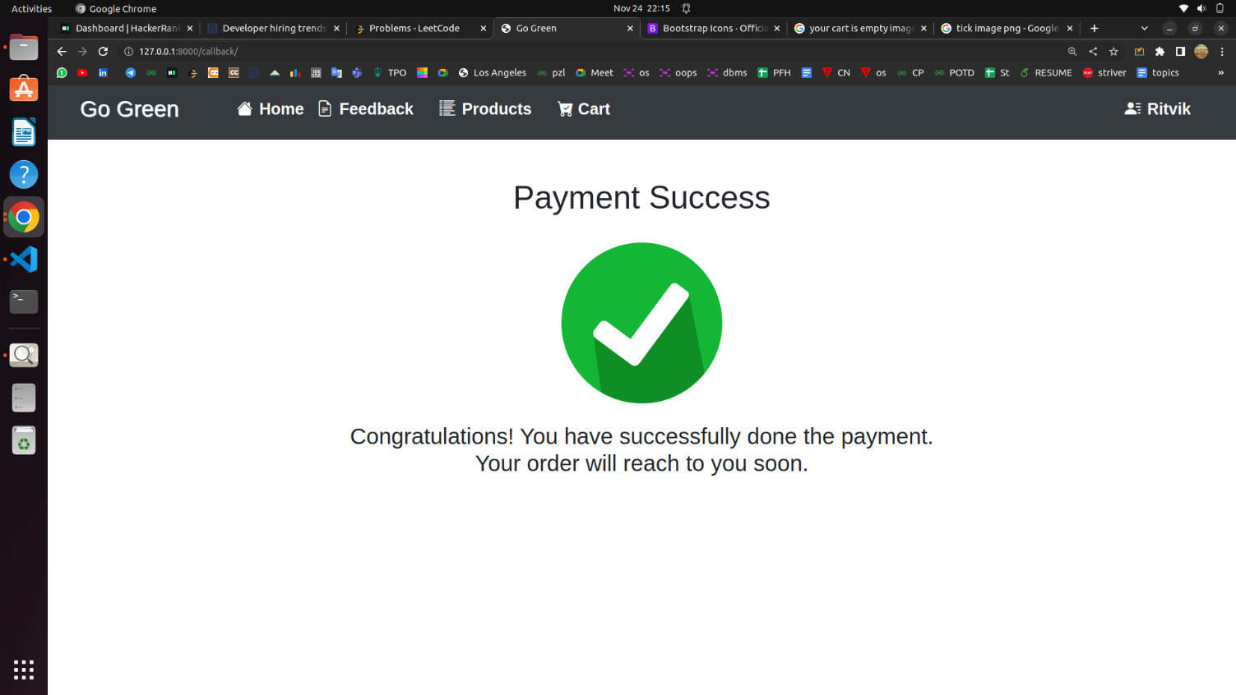
Payment success

Slide 24
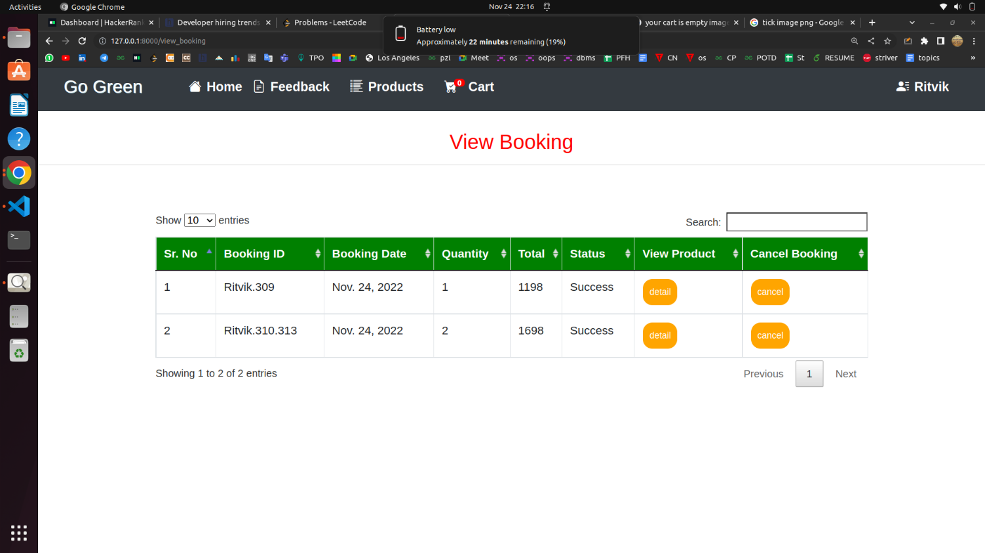
Booking history

Slide 25
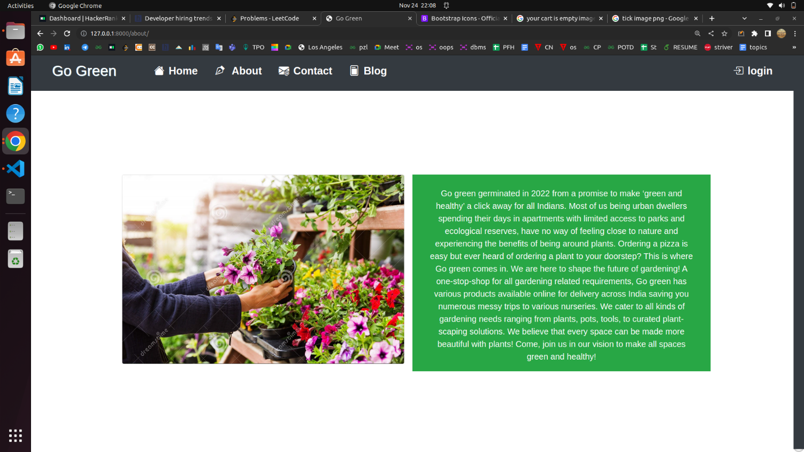
About us

Slide 26
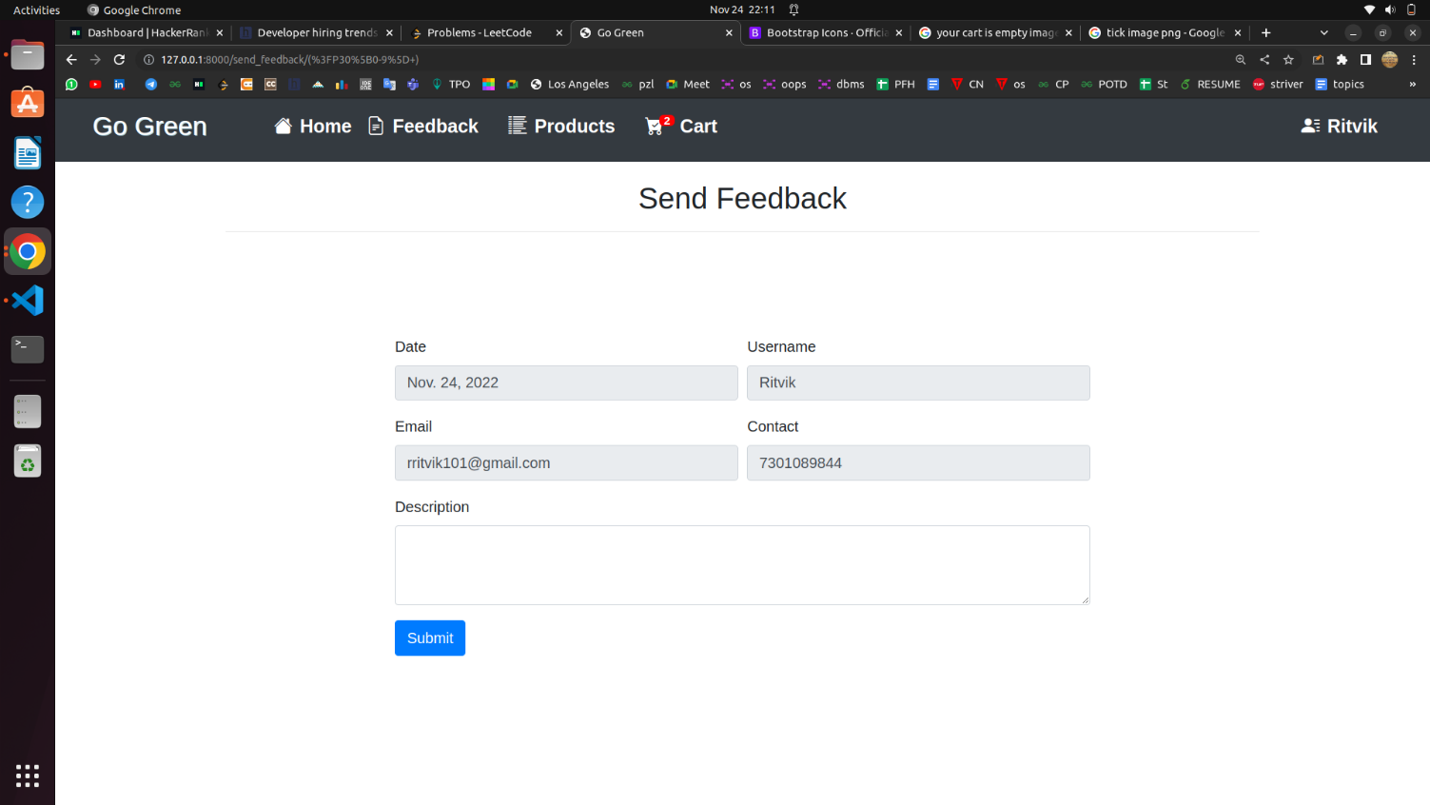
Feedback

Slide 27
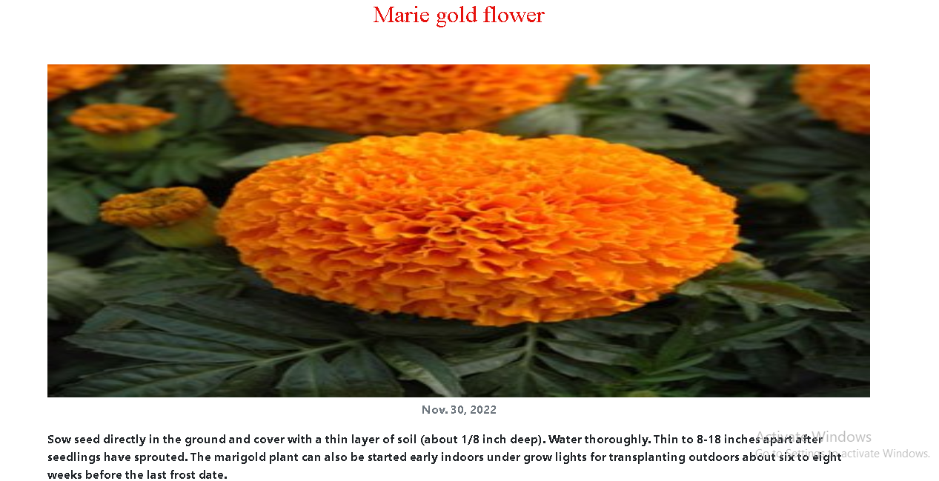
Blog

Slide 28
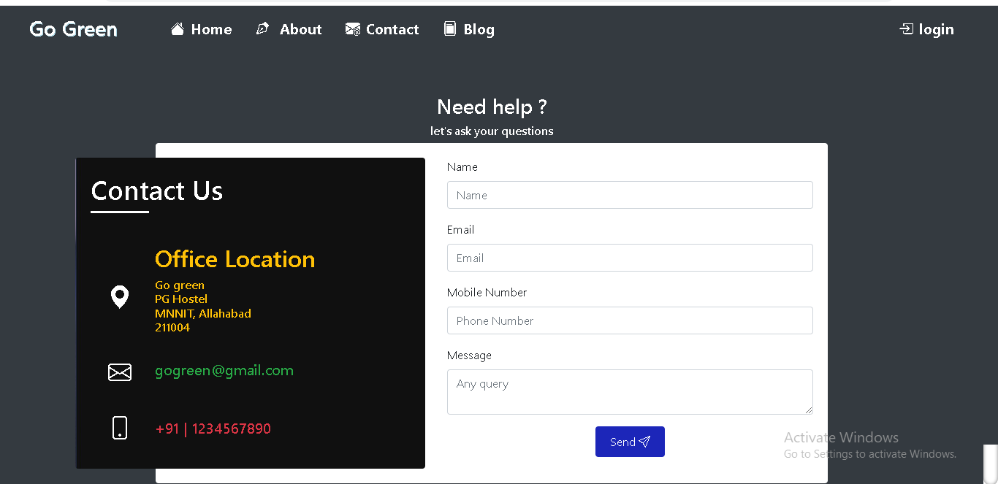
Contact us

Slide 29
Future scope
We will provide customer care support.
We will develop a mobile application to ease the use of online purchasing.
We will enhance the security of website.
We will add a chatbot to resolve the customer issues.

Slide 30
Thank you

